Slide 1
Title
Manufacturing Equipment Output Prediction with Linear Regression
Team Members:
T160500102 – Shraddha Dhore
T160500102- Shreya Deshmukh
T160500141 –Pragati Bhambere
T160500131 – Prachi Phad
T160500127 – Nandita nakat
T160500135 – Prathamesh Raut

Slide 2
Table of Contents
Problem Statement
Overview of the Project
Methodology
Data Collection and Loading
Data Preprocessing
Exploratory data Analysis
Feature Engineering
Model Training
Model Evaluation
Deployment using FatsAPI and Docker
Business Impact
Future Scope
Conclusion

Slide 3
Problem Statement
The objective of this project is to predict the hourly output of manufacturing equipment using machine operating parameters.
By applying Linear Regression, the system can estimate the number of parts produced per hour and help identify optimal operating conditions.
Objectives Predict manufacturing output accurately.
Identify factors affecting machine productivity.
Optimize machine settings for improved efficiency.
Reduce production losses and downtime.
Support data-driven decision-making in manufacturing.

Slide 4
Overview of the Project
This project predicts the hourly output of manufacturing equipment using the Linear Regression algorithm. It utilizes machine-related parameters and production data to estimate equipment performance.
The project includes data preprocessing, exploratory data analysis (EDA), feature engineering, model training, evaluation, and deployment using FatsAPI and Docker. Model performance is measured using MAE, MSE, and R² Score.
The solution enables real-time production output prediction, helping improve operational efficiency and manufacturing decision-making.

Slide 5
Methodology
Data Collection and Loading
Data Preprocessing
Exploratory Data Analysis(EDA)
Feature Engineering
Model Training using Linear Regression
Model Evaluation
Deployment using Streamlit and Docker

Slide 6
Data Collection and Loading
Historical manufacturing equipment data was collected and used to train a Linear Regression model.
The trained model was saved as Linear Regression Model pkI using the Joblib library. In the application, this pre-trained model is loaded at
startup using Python
model = joblib.load("linear_regression_model.pkl")
This allows the API to use the already trained model for prediction without retraining it every time.

Slide 7
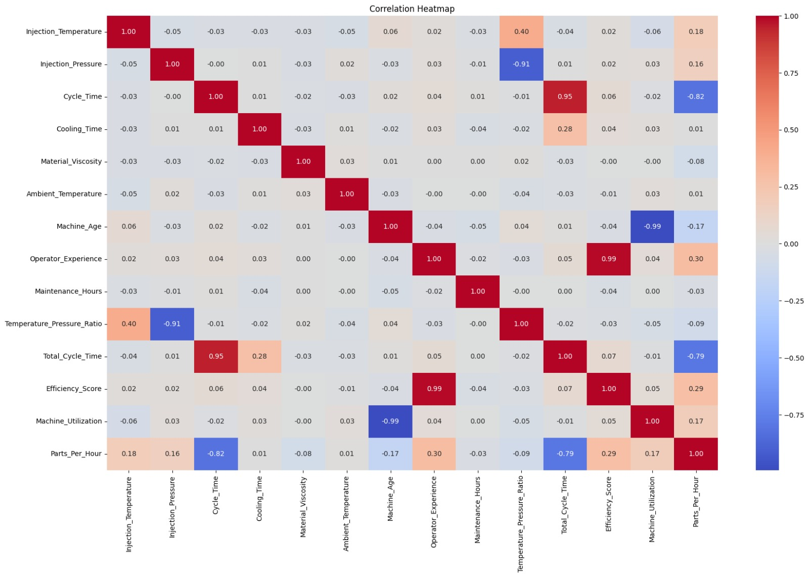
🔥 Heatmap
Displays relationships between manufacturing features and production output.

Slide 8
2.Data Preprocessing
Before training the model, the collected manufacturing data was preprocessed to ensure consistency and accuracy.
Missing values and inconsistencies were handled, and the input features were converted into numerical format.
During prediction, the user-provided feature values are converted into a NumPy array and reshaped into the format required by the model:
This preprocessing ensures that the input matches the format expected by the Linear Regression model.

Slide 9
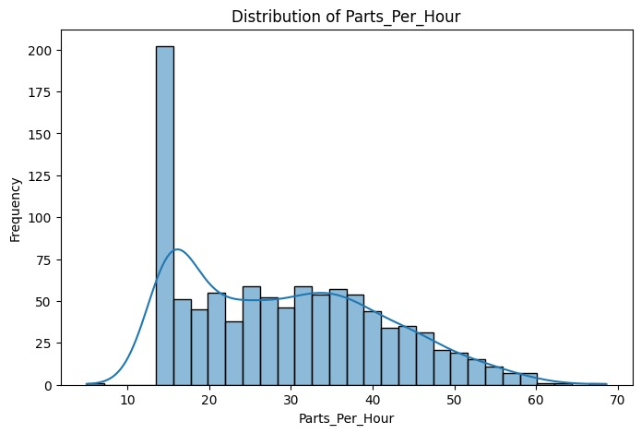
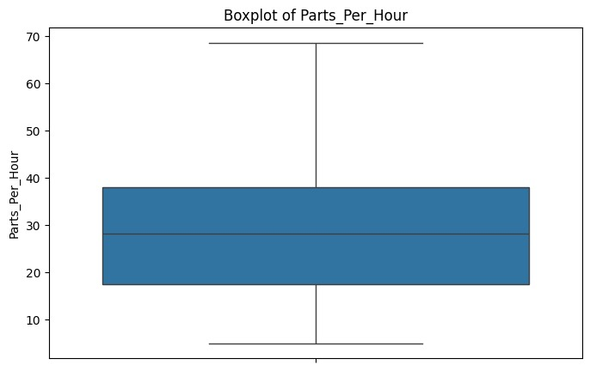
📊 Distribution Plot
📦Box Plot
Shows the distribution of manufacturing output and helps identify data patterns.
Detects outliers and visualizes the spread of manufacturing parameters.

Slide 10
Exploratory Data Analysis
📊 Statistical Analysis → 📈 Trend Analysis →Correlation Study → ✅ Feature Selection
Analysed
manufacturing dataset to understand production patterns.
Examined machine-related parameters affecting output.
Used statistical analysis and data visualization techniques.
Identified trends, correlations, and anomalies in the data.
Evaluated relationships between input features and production output.
most relevant features for model development. Generated insights to improve prediction accuracy.

Slide 11
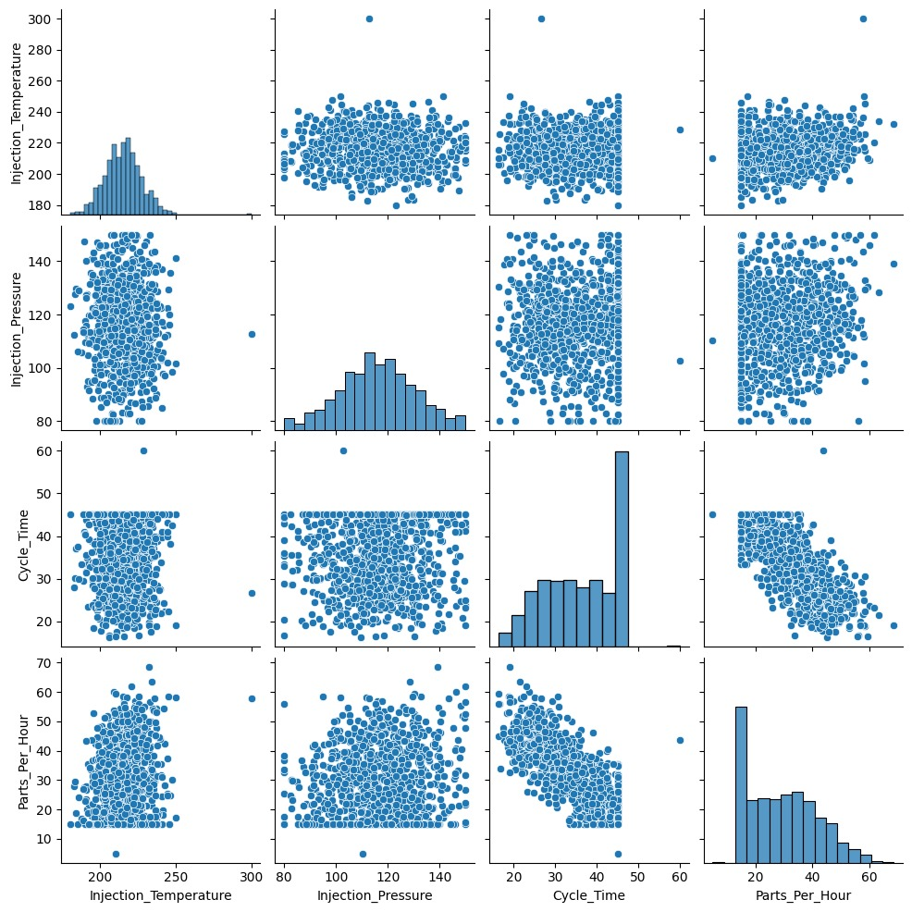
Pair Plot

Slide 12
Feature Engineering
Raw Manufacturing Data Collection of machine and production-related data from manufacturing processes.
Feature Selection dentification of the most relevant variables that influence production output.
Data Preprocessing Cleaning and transforming data to improve quality and consistency.
Model Input (Features List) Selected features are structured and provided to the prediction model.
Production Output Prediction The model estimates the number of parts produced per hour.

Slide 13
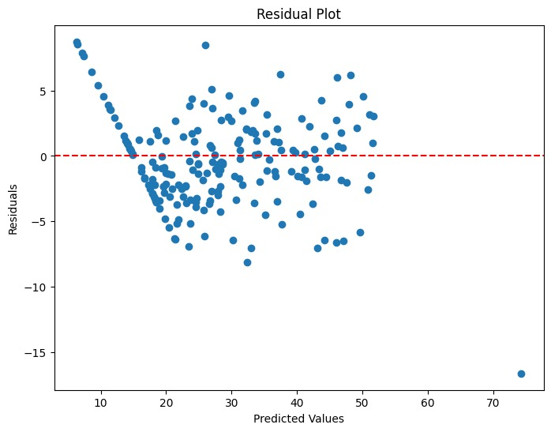
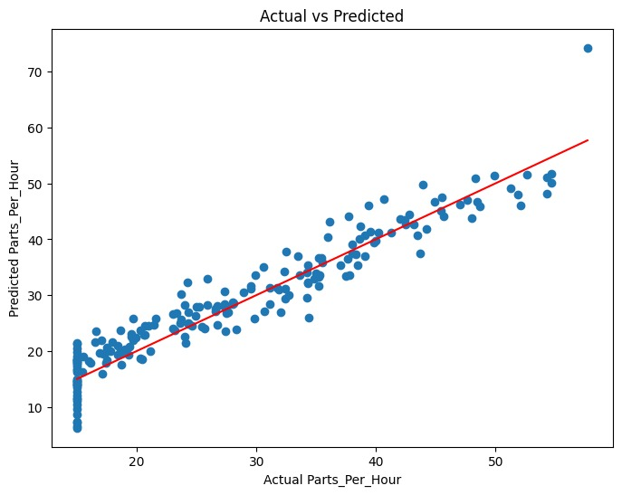
📈Residual Plot
📈 Actual vs Predicted Plot
Compares actual production output with model predictions to evaluate accuracy.

Slide 14
Model training using linear regression
Selected Features ➡️ Input variables prepared for model training.
Linear Regression Algorithm ➡️ Learns the relationship between inputs and production output.
Trained Model ➡️ Generates a prediction model based on learned patterns.
Model Saved (.pkl File) ➡️ Stores the trained model for future deployment and predictions.
Model Training ➡️ Fits the best regression line using historical manufacturing data.

Slide 15
Model evaluation
Testing Data Used unseen data to evaluate model performance.
Generate Predictions Model predicts manufacturing output values.
Compare with Actual Output Predicted values are compared with real values.
Calculate Metrics (MAE, MSE, R²) Quantifies prediction accuracy and model quality.
Performance Assessment Confirms model reliability and effectiveness.
Metric | Value
Mean Absolute Error | 2.7157288381
Mean Squared Error | 12.28033510079
Root Mean Squared Error | 3.5043309062921
R2 Score | 0.905892659066

Slide 16
Deployment using FatsAPI and Docker
🤖 Linear Regression Model
⬇️
⚡ FastAPI Server
⬇️
🐳 Docker Container
⬇️
🌐 REST API (/, /predict)
⬇️
📈 Manufacturing Output Prediction
Deployed the trained Linear Regression model using FastAPI.
Created REST API endpoints for real-time predictions. GET (/) endpoint verifies API availability.
POST (/predict) endpoint receives manufacturing parameters and returns predicted output.
Containerized the application using Docker.

Slide 17
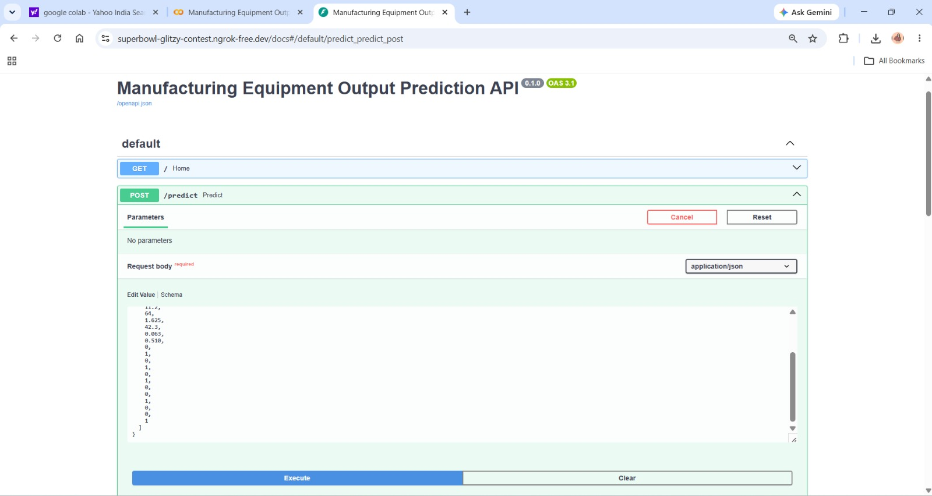
🖥️ Output

Slide 18
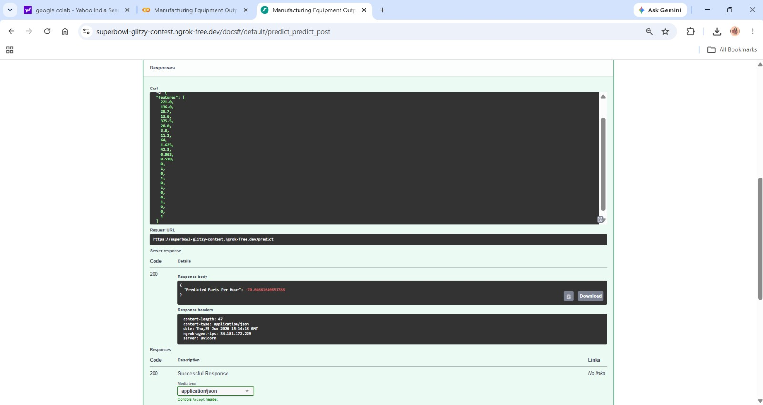

Slide 19
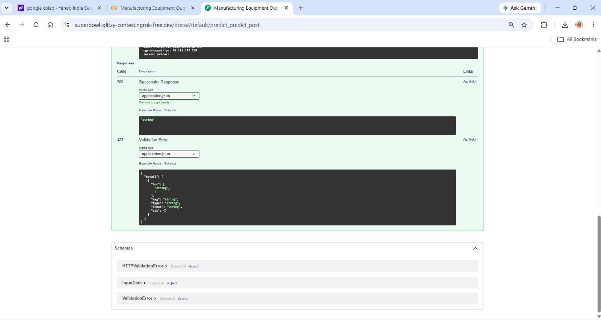

Slide 20
Business Impact
Reduced wastage
Improved efficiency
Data-driven decision making
Production Data Analysis
Output Prediction
Better Planning & Scheduling
Improved Equipment Utilization
Higher Productivity & Cost Efficiency

Slide 21
Future Scope
IoT Integration
Real-time sensor data
Advanced ML models
Predictive maintenance
Smart Production Monitorin
Industry 4.0 Manufacturing System

Slide 22
Conclusion
Linear Regression provides an effective approach for predicting manufacturing equipment output.
The project involved synthetic data generation, exploratory data analysis, feature engineering, and model training, followed by evaluation using metrics such as R², MSE, RMSE, and MAE.
The model helps industries optimize operational parameters, improve production efficiency, reduce costs, and support informed decision-making, leading to enhanced overall productivity.

Slide 23
Thank You
Any Queries ?

